Slide 1
WEBD2075
Web Security

Slide 2
Cryptographic Failure
Web Security

Slide 3
In this lesson
Introduction to Cryptographic Failures (OWASP 2021: A02)
What kind of data should be protected?
EU’s General Data Protection Regulation (GDPR)
Financial Data- PCI Data Security Standard
Different kinds and level of Cryptography
Unencrypted protocols and encrypted protocols
Examples of encryption protocols
Obsolete (e.g. MD5 and SHA1, non-cryptographic hash)
Still considered to be “secured”
Server certification

Slide 4
In this lesson (cont.)
Example- WIFI security development
Before wifi- no encryption (switch vs hub)
Original 802.11- included WEP
WPA TKIP -> WPA2 with AES-CCMP
WPA2 (KRACK attack at 2017) -> WPA3 with SAE (instead of PSK- Pre shared Key)
HTTP to HTTPS, the secured layer
How does HTTPS work?
How can this be used for other protocols
Certificate and Trust train (chain)

Slide 5
In this lesson (cont.)
Related OWASP Annotated Application Security Verification Standard
What is ASVS?
Crypto (V7)
Data Protection (V9)
and SSL/TLS (V10)

Slide 6
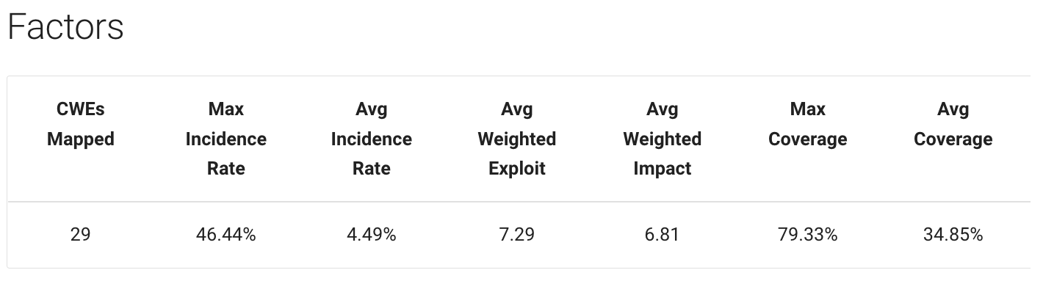
Introduction to Cryptographic Failures (OWASP 2021: A02)
https://owasp.org/Top10/A02_2021-Cryptographic_Failures/#list-of-mapped-cwes

Slide 7

Introduction to Cryptographic Failures (OWASP 2021: A02)
Previously known as Sensitive Data Exposure (OWASP 2017: A03)
Broad symptom rather than a root cause
Failures related to (or lack of) cryptography measures which usually lead to sensitive data exposure
29 Mapped Common Weakness Enumerations (CWE)
https://owasp.org/Top10/A02_2021-Cryptographic_Failures/#list-of-mapped-cwes

Slide 8

What kind of data should be protected?
Before we think of how (cryptography), we should think of the what (data) we need to protect
Common data considered to be “secretive” in nature
Passwords, credit card, health records, etc.
Regulations and laws
EU's General Data Protection Regulation (GDPR)
Financial data protection such as PCI Data Security Standard (PCI DSS)
https://martech.org/wp-content/uploads/2018/09/GDPR-with-stars_wkhip8-600x338.png
https://owasp.org/Top10/A02_2021-Cryptographic_Failures/#list-of-mapped-cwes

Slide 9

GDPR
Scope of data
Does it apply to public data or company data?
What are the definition of personal data under GDPR?
https://dataedo.com/blog/what-is-personal-data-under-gdpr
SCAN and READ about GDPR Personal Data definition

Slide 10

Payment Card Industry Data Security Standard (PCI DSS)
Scope of data
What are the different types of merchants under PCI DSS?
Accreditations for different types of merchant and transaction via Self-Assessed Questionnaire and the corresponding requirements
SCAN and READ about PCI DSS

Slide 11
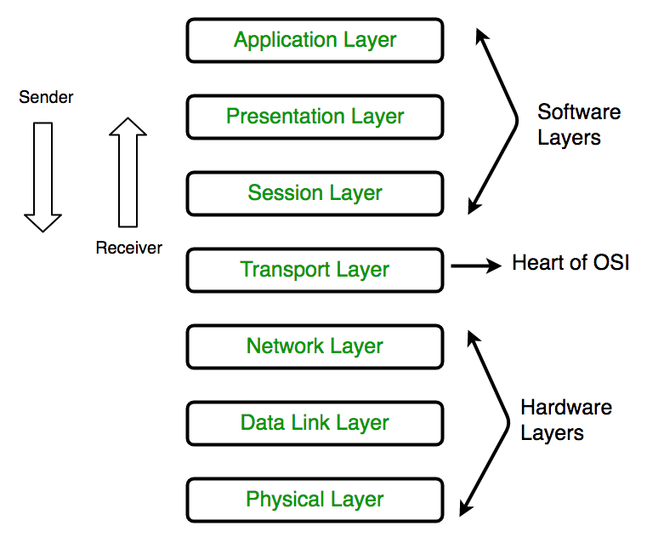
Different kinds and levels of Cryptography
Cryptography is used at almost all layers in a network (usually starts with level 2- Data Link)
Layer 2 (Data Link): Layer 2 Tunnel Protocol (L2TP)
Layer 3 (Network): IP Security (IPSec)
Layer 5/6 (Session/Presentation): Secure Sockets Layer(SSL), Transport Layer Security (TLS)
Layer 7 (Web Applications)
https://media.geeksforgeeks.org/wp-content/uploads/computer-network-osi-model-layers.png
https://owasp.org/Top10/A02_2021-Cryptographic_Failures/#list-of-mapped-cwes

Slide 12

Obsolete Protocols
Hashing Protocols
MD5
SHA1
Related: Cyclic redundancy check (CRC) codes
Padding Methods
PKCS 1 v1.5
SCAN and READ about MD5/SHA-1 and CRC
https://owasp.org/Top10/A02_2021-Cryptographic_Failures/#list-of-mapped-cwes

Slide 13

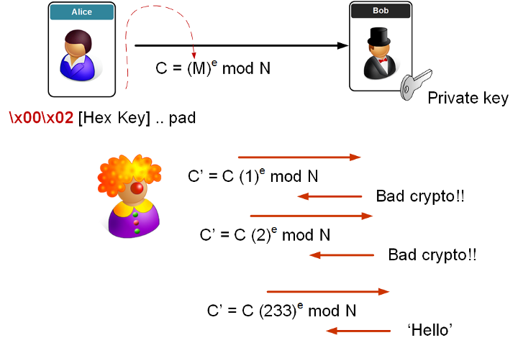
Obsolete Protocols
Padding Methods
PKCS 1 v1.5
PKCS Failure
SCAN and READ about PKCS 1 v1.5 failure
https://medium.com/asecuritysite-when-bob-met-alice/whats-so-special-about-pkcs-1-v1-5-and-the-attack-that-just-won-t-go-away-51ccf35d65b7

Slide 14

Example- WIFI security development
Before Wifi- no encryption (switch vs hub)
Original 802.11- included WEP
WPA TKIP -> WPA2 with AES-CCMP
WPA2 (KRACK attack at 2017) -> WPA3 with SAE (instead of PSK- Pre shared Key)
SCAN and READ about the brief history of insecurities in WEP, WPA and WPA2
https://owasp.org/Top10/A02_2021-Cryptographic_Failures/#list-of-mapped-cwes

Slide 15
HTTP to HTTPS, the secured layer
How does HTTPS work?
How can this be used for other protocols
Certificate and Trust train (chain)

